Slide 1
Experiment No-2
Do requirement analysis and develop Software Requirement Specification Sheet
(SRS) for suggested system.

Slide 2
Description of an SRS
Software Requirement Specification (SRS) is a document that describes the requirements of a computer system from the user's point of view.
An SRS document specifies: The required behaviour of a system in terms of: input data, required processing, output data, operational scenarios and interfaces. The attributes of a system including: performance, security, maintainability, reliability, availability, safety requirements and design constraints.

Slide 3
Major Goals of an SRS
It provides feedback to the customer. An SRS is the customer's assurance that the development organization understands the issues or problems to be solved and the software behaviour necessary to address those problems. Therefore, the SRS should be written in natural language (versus a formal language, explained later in this article), in an unambiguous manner that may also include charts, tables, data flow diagrams, decision tables, and so on.
It decomposes the problem into component parts. The simple act of writing down software requirements in a well-designed format organizes information, places borders around the problem, solidifies ideas, and helps break down the problem into its component parts in an orderly fashion.

Slide 4
It serves as an input to the design specification. As mentioned previously, the SRS serves as the parent document to subsequent documents, such as the software design specification and statement of work. Therefore, the SRS must contain sufficient detail in the functional system requirements so that a design solution can be devised.
It serves as a product validation check. The SRS also serves as the parent document for testing and validation strategies that will be applied to the requirements for verification.

Slide 5
IEEE –SRS DOCUMENT TEMPLATE
1. Introduction
1.1 Purpose
1.2 Scope
1.3 Definitions, Acronyms, and Abbreviations
1.4 References
1.5 Overview

Slide 6
Overall Description
2. The Overall Description
2.1 Product Perspective
2.1.1 System Interfaces
2.1.2 User Interfaces
2.1.3 Hardware Interfaces
2.1.4 Software Interfaces
2.1.5 Communication Interfaces
2.1.6 Memory Constraints
2.1.7 Operations
2.1.8 Site Adaptation Requirements

Slide 7
2.2 Product Functions
2.3 User Characteristics
2.4 Constraints
2.5 Assumptions and Dependencies
2.6 Apportioning of Requirements

Slide 8
3. Specific Requirements
3.1 External Interface Requirements
3.2 Functions
3.3 Performance Requirements
3.4 Logical Database Requirements
3.5 Design Constraints
3.5.1 Standard Compliance

Slide 9
3.6 Software System Attributes
3.6.1 Reliability
3.6.2 Availability
3.6.3 Security
3.6.4Maintainability
3.6.5 Portability

Slide 10
3.7 Organising the specific Requirements
3.7.1 System Mode
3.7.2 User Class
3.7.3 Objects
3.7.4 Feature
3.7.5 Stimulus
3.7.6 Response
3.7.7 Functional Hierarchy
3.8 Additional Comments

Slide 11
4. Change Management Process
5. Documents Approvals
6. Supporting Information
7. Conclusion

Slide 12
SRS of Railway Reservation System
1. INTRODUCTION
This document aims at defining the overall software requirements for ‘RAILWAY RESERVATION SYSTEM’. Efforts have been made to define the requirements exhaustively and accurately. The final product will be having only features/functionalities mentioned in this document and assumptions for any additional functionality/feature should not be made by any of the parties involved in developing/testing/implementing/ using this product. In case it is required to have some additional features a formal change request will need to be raised and subsequently a new release of this document and/or product will be produced.

Slide 13
1.1 PURPOSE
This specification document describes the capabilities that will be provided by the software application ‘RAILWAY RESERVATION SYSTEM’. It also sates the various required constraints by which the system will abide. The intended audiences for this document are the development team, testing team and end users of the product.
1.2 SCOPE
The software product ‘RAILWAY RESERVATION SYSTEM’ is an application that will be used for ticketing, reservation, cancellation and management of railway system for our government. The application will manage the information about various passengers which travel through the railways, through which train they want to travel, where the want to travel, distance between the two cities, what is the current status and the status of next three days of the reservation, what is the fare, what is the class through they want to travel and their personal records. Printable tickets for the passengers will also be generated.
This application will greatly simplify and speed up the result preparation and management process.

Slide 14
1.3 DEFINITIONS, ACRONYMS AND ABBREVIATIONS
The following abbreviation has been used throughout this document
PNR: Passenger Name Record
RAC: Reservation Against Cancellation.
WL: Waiting List.
1.4 REFERENCES
(i) Website: For more information, log on to www.indianrail.gov.in
1.5 OVERVIEW
The rest of this SRS document describes the various system requirements, interfaces, features and functionalities in detail.

Slide 15
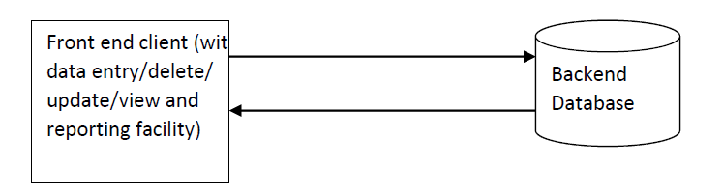
2.OVERALL DESCRIPTION
2.1 PRODUCT PERPECTIVE
The application will be a windows-based, self-contained and independent software product.
2.1.1 SYSTEM INTERFACES
None

Slide 16
2.1.2 USER INTERFACES
The application will have a user-friendly and menu based interface. Following screens will be provided:
(i) A login screen for entering the username, password and role (Reservation Clerk, Administrator, Coordinator) will be provided. Access to different screen will be based upon the role of the user.
(ii) There will be a screen for capturing and displaying information regarding what trains are scheduled during which date, how much is the fare, and what are the classes in the trains.
(iii) There will be a screen for capturing and displaying information regarding various passenger’s seats reserved in different trains.
(iv) There will be a screen for capturing and displaying information regarding which passenger is currently reserved in which train and what is the class of that seat.
(v) There will be a screen that will capture information regarding the discount in the fare of the ticket. Discount will be given on various basis like senior citizen, student concession, scheduled cast etc.
(vi) There will be a screen for capturing and displaying information regarding which all user account exist in the system, thus showing who all can access the system.

Slide 17
The following reports will be generated:
(i) Reservation Chart: Printable report will be generated to show the list of the passengers reserved in a particular train along with the class of their travel.
(ii) RAC Chart: Printable report will be generated to show to show the list of passengers who are getting their seats in RAC in a particular train.
(iii) Waiting List: Printable reports will be generated to show the list of the passengers who are in the waiting list of the reservation for their seats in a particular train.
(iv) Monthly Report: Monthly report will be generated for the railway department to show how many passengers have traveled during the particular month.

Slide 18
2.1.3 HARDWARE INTERFACES
(i) Screen resolution of at least 800x600-required for proper and complete viewing of screen. Higher resolution would not be a problem.
(ii) Support for printer (dot –matrix /DeskJet /inkjet etc –any will do)-that is, appropriate drivers are installed and printer connected printers will required for printing of reports.
(iii) Standalone system or network based-not a concern, as it will be possible to run the application on any of these.
2.1.4 SOFTWARE INTERFACES
(i) Any window -based operating system (window 95/98/2000/XP/NT).
(ii) MS access 2000 as the DBMS—for database. Future release of the application will aim at upgrading to oracle 8i as the DBMS.
(iii) Crystal reports 8—for generating and viewing pay slips and discharge slips.
(iv) Visual Basic 6—for coding /developing the software.

Slide 19
Software mentioned in pts. (iii) and (iv) above will be required only for development of the application. The final application will be packaged as an independent setup program that will be delivered to the client (hospital in this case).
2.1.5 COMMUNICATION INTERFACES
None
2.1.6 MEMORY CONSTRAINTS
At least 64 MB RAM and 2 GB space on hard disk will be required for running the program.
2.1.7 OPERATIONS
This product release will not cover any automated housekeeping aspects of the database. The DBA at the client site (i.e., Railways) will be responsible for manually deleting old/non-required data. Database backup and recovery will also have to be handled by the DBA. However, the system will provide a ‘RESET SYSTEM’ function that will delete (upon conformation from the administrator) all the existing information from the database.

Slide 20
2.1.8 SITE ADAPTATION REQUIREMENTS
The terminals at client site will have to support the hardware and software interface specified in above section.
2.2 PRODUCT FUNCTIONS
The system will allow access only to authorized users with specific roles. Depending upon the user’s role he/she will be able to access only specific modules of the system.
A summary of the major functions that the software will perform:
(i) A LOGIN facility for enabling only authorized access to the system.
(ii) User (with role Reservation Clerk) will be able to add/modify/delete information about different passengers that are reserving their ticket in different trains and dates.
(iii) User (with role Reservation Clerk) will be able to add/modify/delete information about different seats that are offered in a train (1AC, 2AC, 3AC, Sleeper). The Reservation list of passengers along with their class should be displayed.
(iv) User (with role Reservation Clerk) will be able to add/modify/delete information about the waiting list of the passengers and their RAC.
(v) User (with role Reservation Clerk) will be able to print the ticket of the passenger.
(vi) User (with role Administrator) will be able to generate printable reports.
(vii) User (with role Administrator) will be able to ‘Reset’ the system – leading to deletion of all existing information from the backend database.
(viii) User (with a role Administrator) will be able to create/ modify/ delete new/ existing user accounts.

Slide 21
2.3 USER CHARACTERISTICS
(i) Educational Level- At least a graduate should be comfortable with English.
(ii) Experience- Should be well informed about the features concerning railways. Technical expertise-Should be comfortable with general purpose applications of computer.
(iii) Technical expertise-Should be comfortable with general purpose applications of computer.
2.4 CONSTRAINTS
(i) Since the DBMS being used in MS access 2000, which is not a very powerful DBMS it will not be able to store a very huge number of records.
(ii) Due to limited features of DBMS being used performance tuning features will not be applied to the queries and thus the system may become slow with the increase in the records being stored.
(iii) Due to limited features of DBMS being used, database auditing will also not be provided.
(iv) Users at Railway Reservation will have to implement a security policy to safeguard the passenger related information from being modified by unauthorized users (by means of gaining access to the backend database).

Slide 22
2.5 ASSUMPTIONS AND DEPENDENCIES
The numbers of seats in a train are fixed. There should be no additions in the number of births.
2.6 APPORTIONING OF REQUIREMENTS
None.
3.SPECIFIC REQUIREMENTS
This section contains the software requirements to a level of detail sufficient to enable designers to design the system, and testers to test that system.

Slide 23
3.1 EXTERNAL INTERFACE REQUIREMENTS
3.1.1 USER INTERFACES
The following screens will be provided:
Login Screen:
This will be the first screen that will be displayed. It will allow user to access different screens based upon the user’s role. Various fields available on this screen will be:
(i) User ID: Alphanumeric of length upto 10 characters.
(ii) Password: Alphanumeric of length upto 8 characters.
(iii) Role: Will have the following values:
Administrator, Coordinator, Reservation Clerk.
Train Info Parameters Screen:
This screen will be accessible only to user with role Administrator. It will allow the user to enter the name of train for which the user wants to access the train information.

Slide 24
Train Information Screen:
This screen will be accessible only to user with role Administrator. It will allow user to add/modify/delete information about new/existing train(s) for a particular date that was selected in the ‘Train Info Parameters’ screen. The list of available seats for that train will also be displayed. Various fields available on this screen will be:
(i) Train number: of format T#### (# represent a digit).
(ii) Train Name: Alphanumeric of length upto 50 characters.
(iii) Seats: Number of total seats in each class section of the train.
Passenger Info Parameters Screen:
This screen will be accessible only to user with role Administrator. It will allow the user to enter the train number for which the user wants to access the passenger information.

Slide 25
Passenger Information Screen:
This screen will be available only to role Administrator. It will allow the user to add/modify/delete information about new/existing student(s) for a particular train number. Train wise list of passenger will also be displayed. Various fields available on these screens will be:
(i) PNR number: of the format PNR########## (# represent Alphanumeric digits).
(ii) Passenger Name: will have only alphabetic letters and length upto 40 characters.
(iii) Sex: will have only one alphabet either ‘M’ or ‘F’.
(iv) Age: will have only three digits.
(v) Train number: of the format T#### (# represent a digit).

Slide 26
Passenger’s Train Choice Parameters Screen:
This screen will be accessible only to user with role Administrator. It will allow the user to enter the train number and the class of the travel for which the user wants to access the passenger’s train choice information.
Passenger’s Train Choice Information Screen:
This screen will be accessible only to user with role Administrator. It will allow the user to add/modify/delete passenger’s choices for the trains selected in ‘Passenger’s Train Choice Parameters’ screen. For the selected train it will display the list of seats available in the choices of the passenger. The screen will display the list of passengers who have been allotted the seat. The user will be able to view/add/modify/delete the passenger’s choice in the list.
Passenger Entry Info Screen:
This screen will be accessible only to user with role Reservation Clerk. It will allow the user to enter the train number and the class of the train for which the user wants to access the passenger information.

Slide 27
Non Availability Info Screen:
This screen will be accessible to the user with the role Administrator. It will display the error message to the user about the non-availability of the seats in the current train and class. It allows user to enter another choice for the train number and class. It also allows the user if he wants to continue reserving in the current train and class in the waiting section.

Slide 28
Passenger Entry Screen:
This screen will be accessible only to user with role Reservation Clerk. It will allow user to add/modify/delete information about the seats reserved by different passengers who have been or are going to be allotted seats in the train number and class selected in the ‘Passenger Entry Info’ screen. The screen will display the list of passengers currently who have been allocated the seats. The user will be able to view/add/modify/delete the passenger information in the list. Various fields available on this screen will be:
(i) PNR number: PNR number of all passengers in the current train.
(ii) Passenger Name: will display the name of passenger.
(iii) Sex: will display the sex of the passenger.
(iv) Age: will display the age of the passenger.
(v) Status: will display the status of the reservation i.e. whether the passenger has been allotted the seat and its seat number or is in RAC or WL.Passenger Parameters Screen:
This screen will be accessible only to user with role Reservation Clerk. It will allow the user to enter the PNR number and the Train number of the passenger for whom the user wants to view/print the ticket.

Slide 29
Passenger List Report Parameters:
This screen will be accessible only to user with role Coordinator. It will allow the user to enter the train number for which the user wants to view/print the passenger list report.
RAC List Parameters Screen:
This screen will be accessible only to user with role Coordinator. It will allow the user to enter the train number for which the user wants to view/print the RAC list report.
WL List Parameters Screen:
This screen will be accessible only to user with role Coordinator. It will allow the user to enter the train number for which the user wants to view/print the WL report.
Monthly Passenger List Report Parameters:
This screen will be accessible only to user with role Coordinator. It will allow the user to enter the month for which the user wants to view/print the passenger list report.

Slide 30
3.1.2. HARDWARE INTERFACES
As stated in section 2.1.3.
3.1.3 SOFTWARE INTERFACES
As stated in section 2.1.4.
3.1.4 COMMUNICATIONS INTERFACES
None.
3.2 SOFTWARE PRODUCT FEATURES
3.2.1 TRAIN INFORMATION MAINTENANCE
Description:
The system will maintain information about various trains being offered to the passengers. The following information would be maintained for each train:
Train number, train name, train type (superfast, express, passenger, mail etc.), total seats, classes, number of the station the train will pass through.
The system will allow creation/modification/deletion of new/existing trains.

Slide 31
Validity Checks:
(i) Only user with role Administrator will be authorized to access the Train information Maintenance module.
(ii) Each compartment will have a maximum of 72 seats.
(iii) Each train will have atleast two classes.
(iv) Train number will be different for each train.
(v) Train number cannot be blank.
(vi) PNR number cannot be blank.
(vii) Train name cannot be blank.
(viii) Number of seats cannot be zero.
Sequencing Information:
Train info will have to be entered in the system before any info regarding passenger is entered.
Error Handling/ Response to Abnormal Situations:
If any of the above validations/ sequencing flow does not hold true, appropriate error msg. will be prompted to user for doing the needful.

Slide 32
3.2.2 PASSENGER INFORMATION MAINTENANCE
Description:
The system will maintain information about various passengers allotted seats or are waiting to be allotted seats in different trains. The following information would be maintained for each train:
Train number, PNR number, Class, Passenger Info.
The system will allow creation/modification/deletion of new/existing passengers and also have the ability to list all the passengers allotted or are waiting to be allotted seats in a particular train.
Validity Checks:
(i) Only user with role Reservation Clerk will be authorized to access the Passenger Information Maintenance module.
(ii) Every passenger will have a unique PNR number.
(iii) PNR number cannot be blank.
(iv) Passenger name cannot be blank.
(v) Train number cannot be blank.

Slide 33
Sequencing Information:
Train info will have to be entered in the system before any info regarding passenger is entered.
Error Handling/ Response to Abnormal Situations:
If any of the above validations/ sequencing flow does not hold true, appropriate error msg. will be prompted to user for doing the needful.

Slide 34
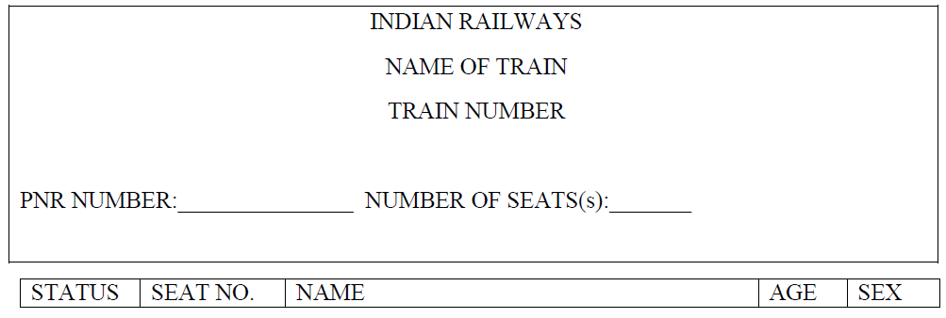
3.2.3 TICKET GENERATION
Description:
The system will generate ticket for every passenger in different trains.
TICKET WILL HAVE THE FOLLOWING FORMAT:

Slide 35
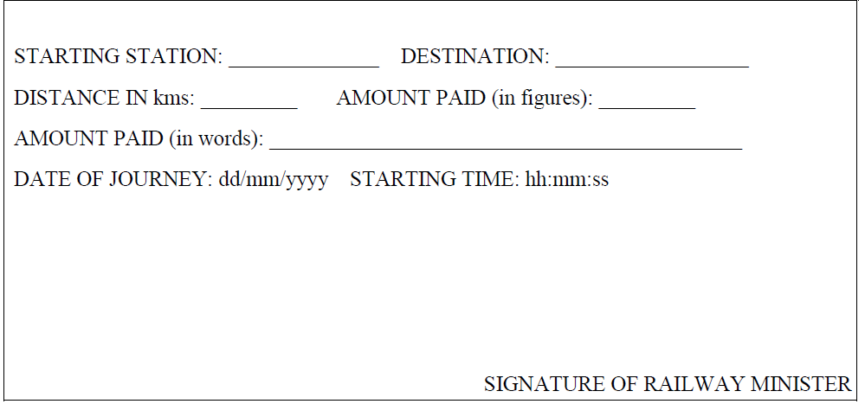

Slide 36
Validity Checks:
(i) Only User with role Coordinator will be authorized to access the Ticket Generation module.
Sequencing Information:
Ticket for a particular passenger can be generated by the system only after PNR number has been entered in the system for a given train number, the passenger info for that ticket has been entered in the system, the choice for the train has been entered in the system, the journey date, and the amount has been paid to the reservation clerk.
Error Handling/ Response to Abnormal Situations:
If any of the above validations/ sequencing flow does not hold true, appropriate error msg. will be prompted to user for doing the needful.

Slide 37
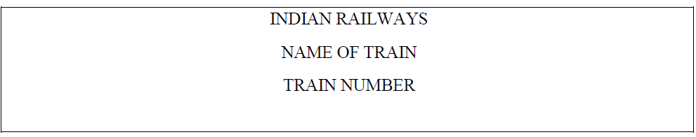
3.2.4 REPORT GENERATION
Passenger List and RAC Report:
For each train a passenger list and a RAC list will be generated containing the list of passengers who have been allotted seats in the train.

Slide 38
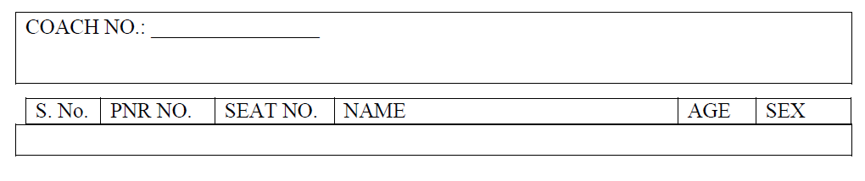

Slide 39
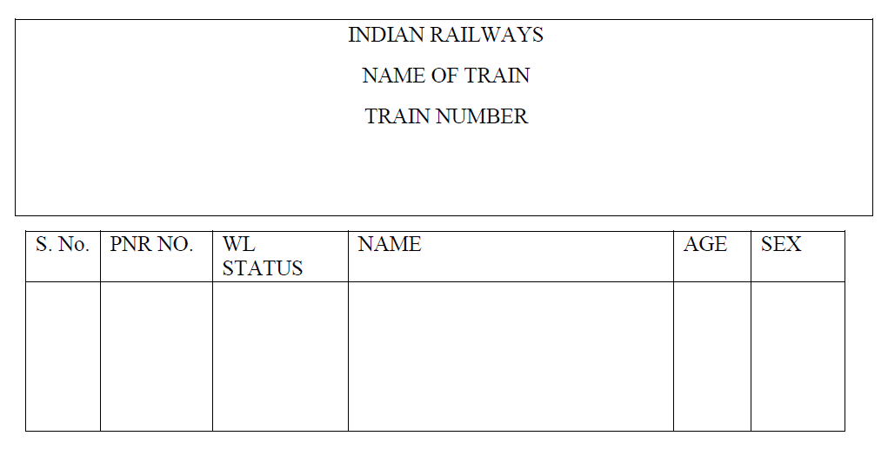
WL Report: For each train a WL will be generated containing the list of passengers who are waiting to get the seats allotted in a train.

Slide 40
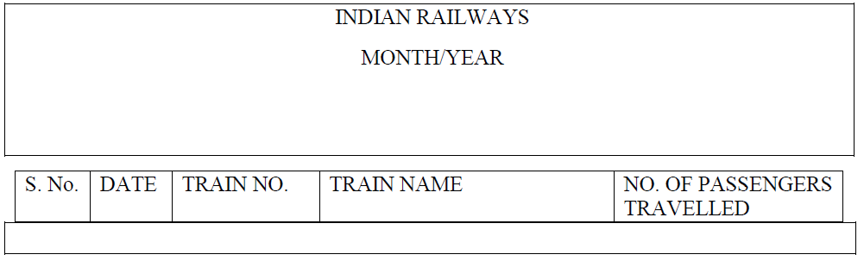
Monthly Passenger List Report: For each month a passenger list will be generated containing the information about the number of passengers traveling each day and through each train.

Slide 41
3.2.5 USER ACCOUNTS INFORMATION MAINTENANCE
Description: The system will maintain information about various users who will be able to access the system. The following information would be maintained:
User Name, User ID, Password, and Role.
Validity Checks:
(i) Only user with role Administrator will be authorized to access the User Accounts Information Maintenance module.
(ii) User Name cannot be blank.
(iii) User ID cannot be blank.
(iv) User ID should be unique for every user.
(v) Password cannot be blank.
(vi) Role cannot be blank.

Slide 42
Sequencing Information:
User Account for particular user has to be created in order for the system to be accessible to that user. AT system startup, only a default user account for ‘Administrator’ would be present in the system.
Error Handling/ Response to Abnormal Situations:
If any of the above validations/ sequencing flow does not hold true, appropriate error msg. will be prompted to user for doing the needful.
3.3 PERFORMANCE REQUIREMENTS
None
3.4 DESIGN CONSTRAINTS
None

Slide 43
3.5 SOFTWARE SYSTEM ATTRIBUTES
3.5.1 SECURITY
The application will be password protected. Users will have to enter correct username, password and role in order to access the application.
3.5.2 MAINTAINABILITY
The application will be designed in a maintainable manner. It will be easy to incorporate new requirements in the individual modules (i.e., new trains, new timings, fare hike).

Slide 44
3.5.3 PORTABILITY
The application will be easily portable on any windows-based system that has MS-Access 2000 installed.
3.6 LOGICAL DATABASE REQUIREMENTS
The following information will be placed in the database:
(i) Passenger Info.
(ii) PNR Number.
(iii) Destination.
(iv) Train Number.
3.7 OTHER REQUIREMENTS
None.
Conclusion: The SRS was written successfully by following the template described above.

Slide 45
Thank you

